Slide 1

Assignment 4 SIFT
Alessandro berti
MSC ICT SOLUTIONS ARCHITECT
Code in slides
https://github.com/Brotherhood94

Slide 2



Scale Invariant Feature Transform
What can I do?
Track
Detect
Identify
It’s not only about scaling…
Rotation
Illumination
«partly»
Viewpoint
It works also on partly hidden objects!

Slide 3



A very first intuition
Cup is here!

Slide 4
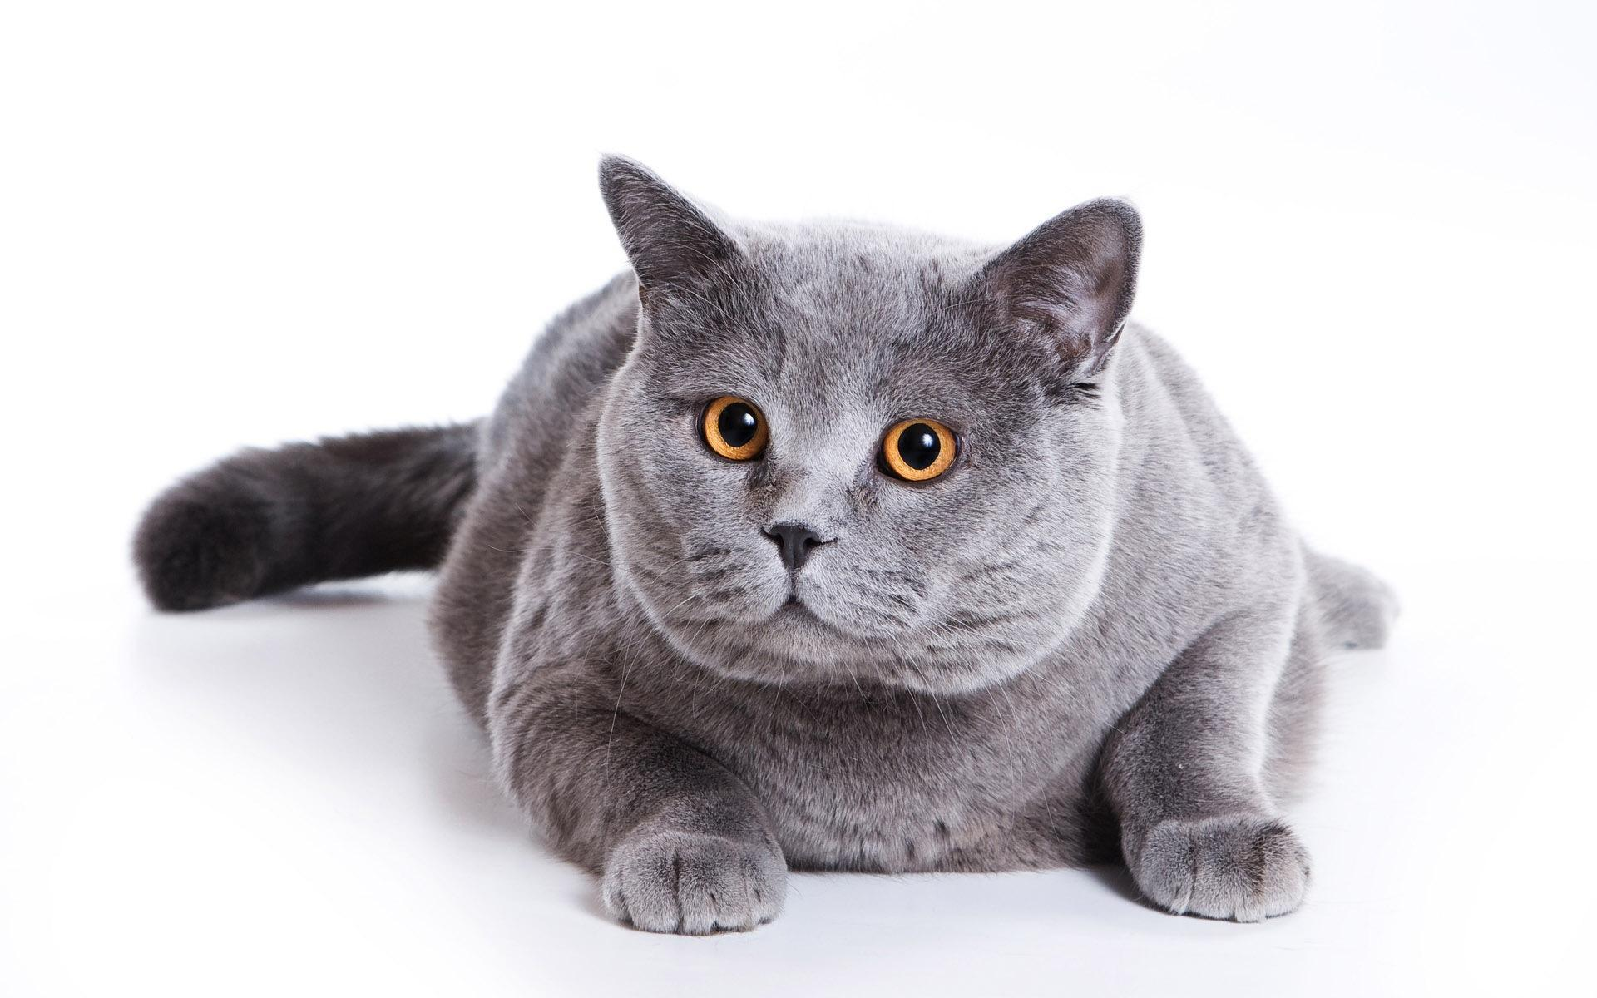




1° Octave
2° Octave
3° Octave
4° Octave
BLUR LEVELS

Slide 5
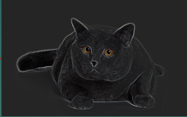
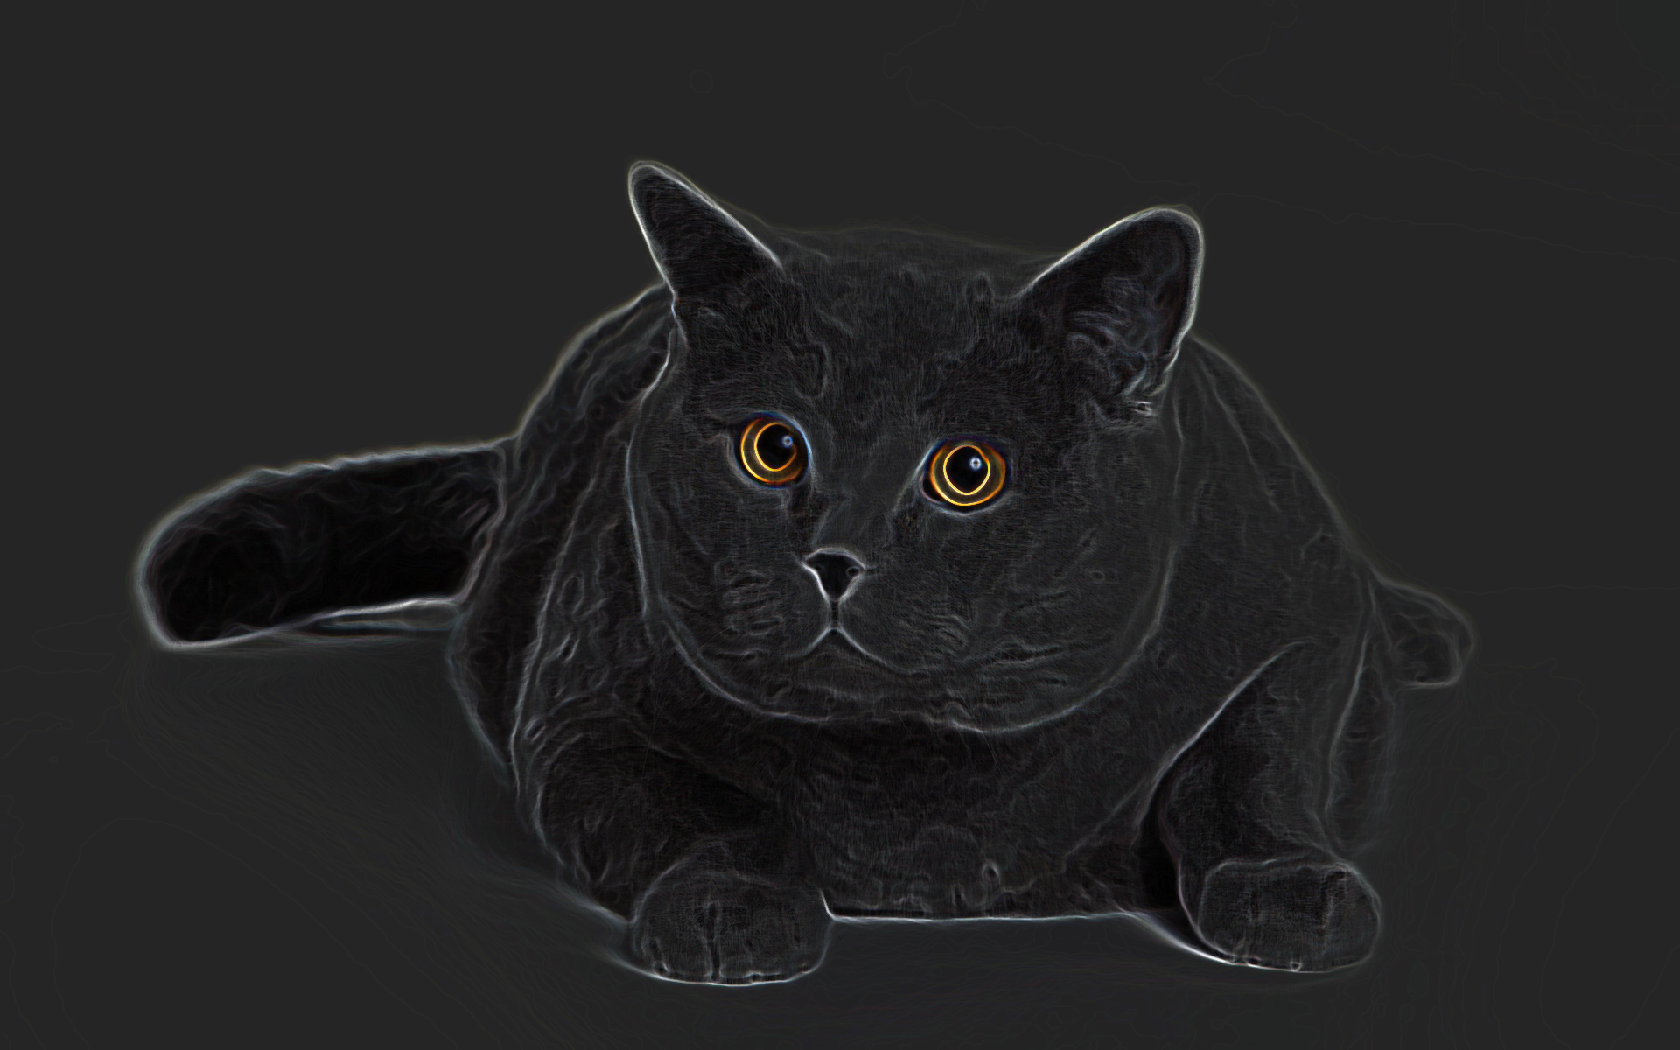
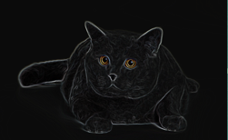
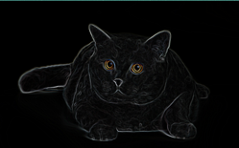
DoG
Local
Maxima/Minima
-
-
S
Right eye
-
S
Left eye
-
KEYPOINTS!

Slide 6
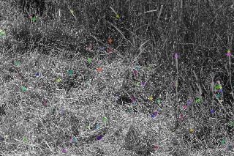
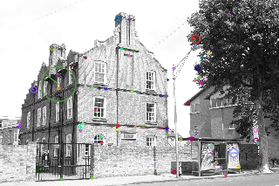
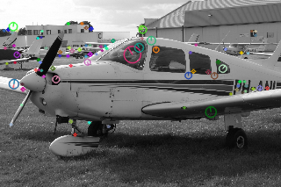
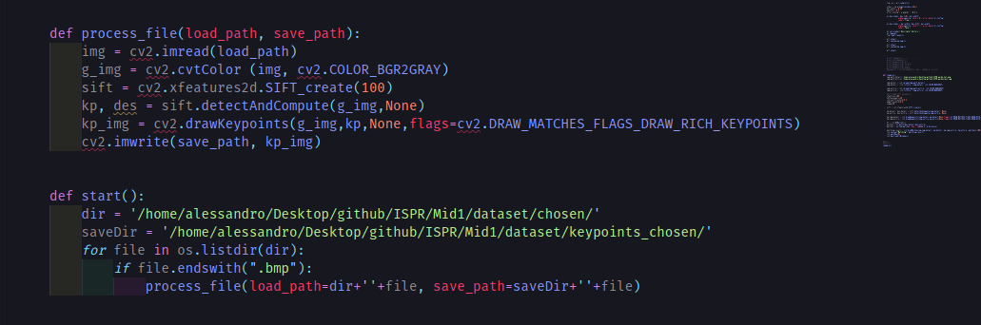
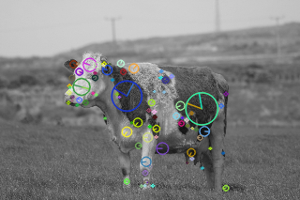
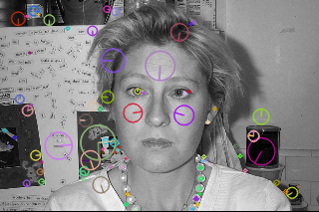
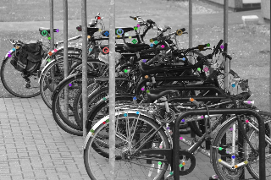
Some samples…

Slide 7






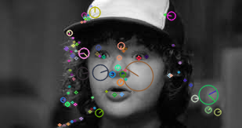

In some sense..
““SEGMENTATION””

Slide 8
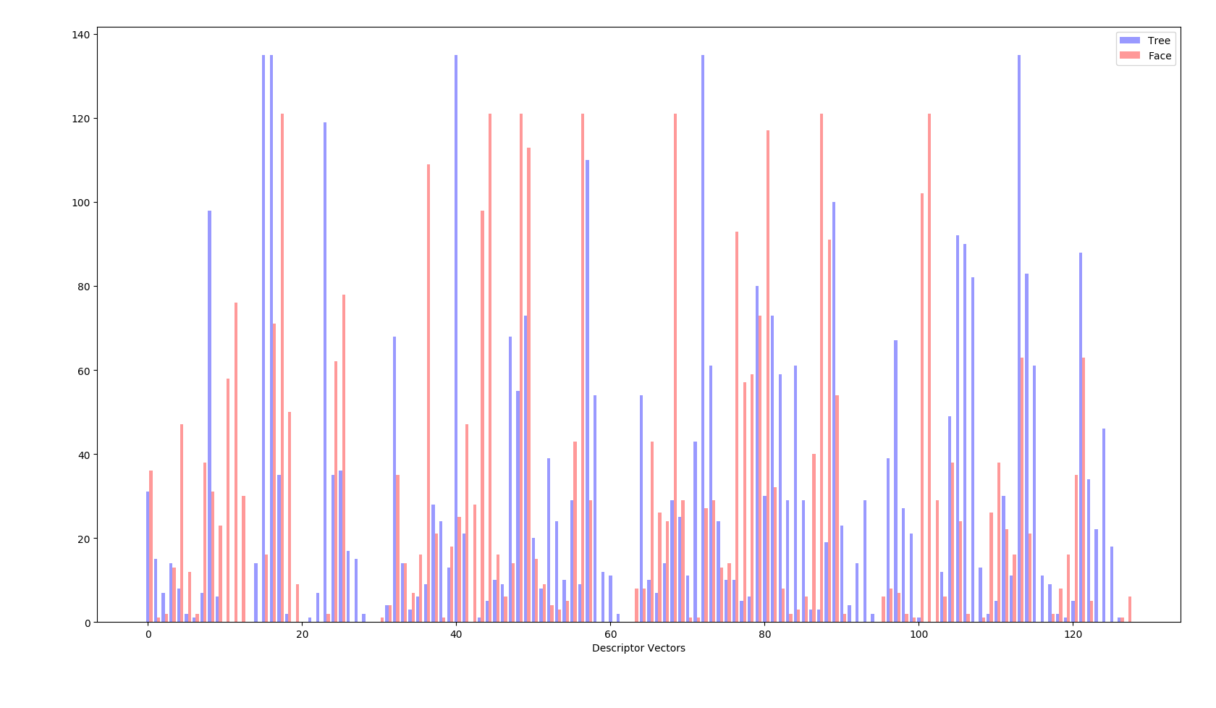
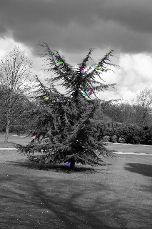
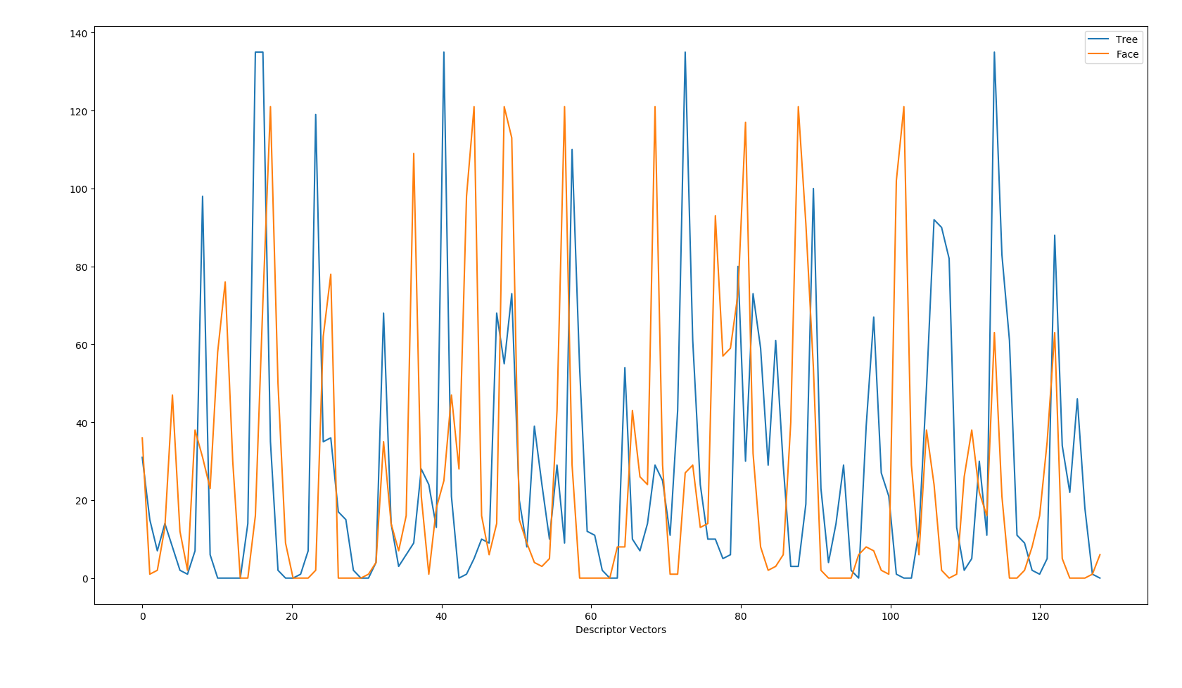
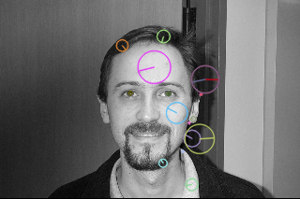
Comparing KeyPoints

Slide 9

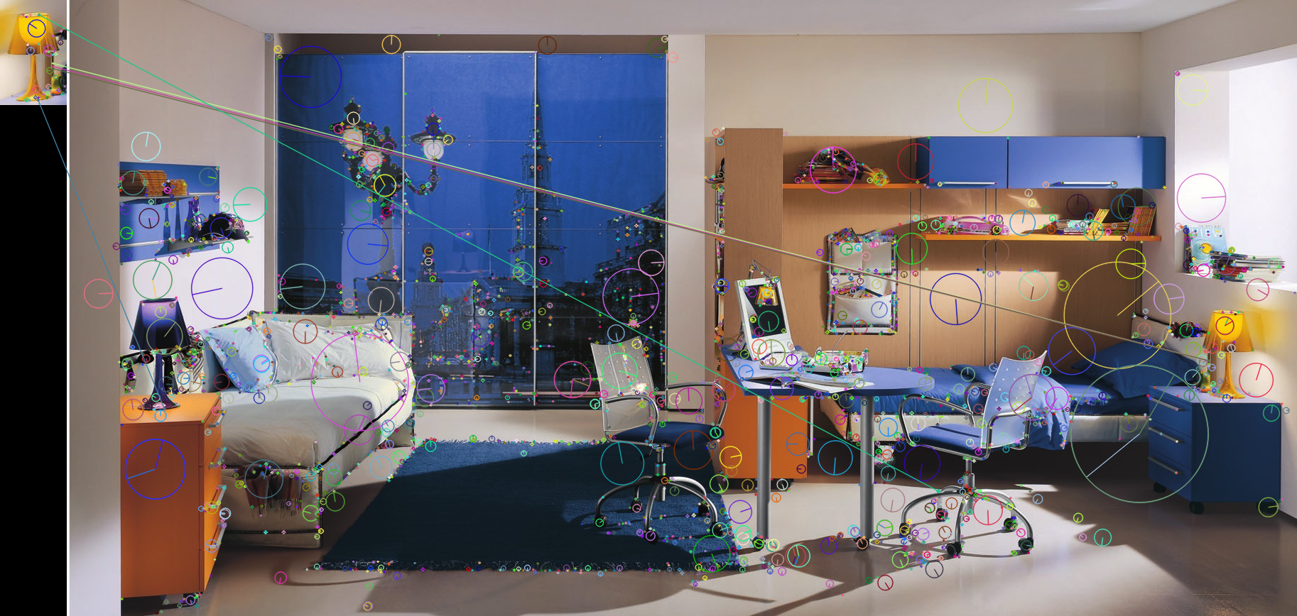
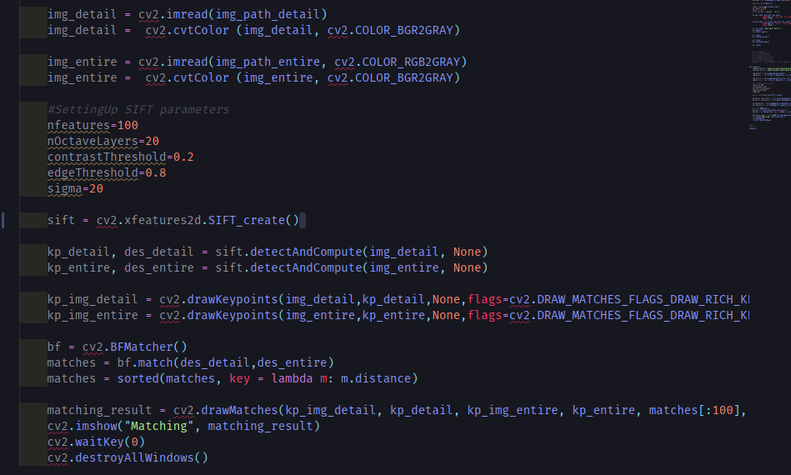
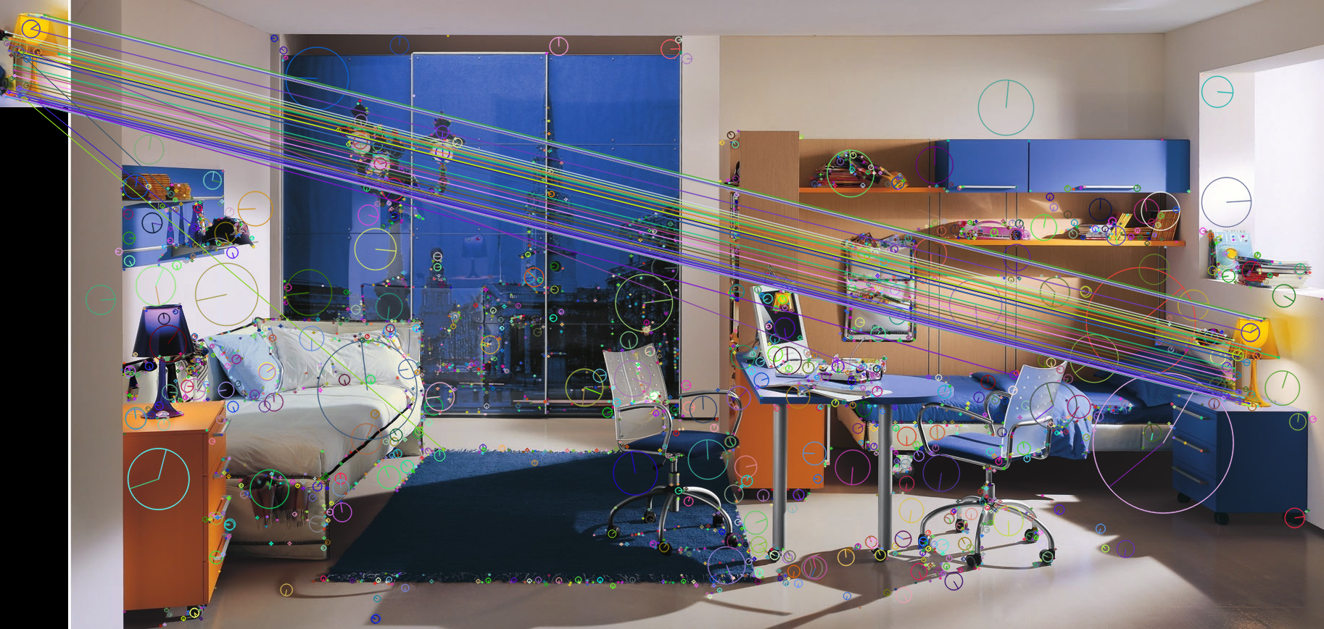
Playing
WHAT HAS CHANGED?
Notes:
Distance

Slide 10
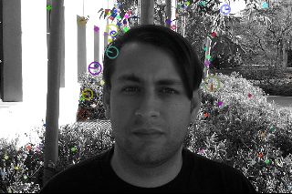
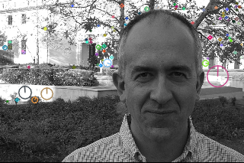
The very last thing…

Slide 11
CONCLUSION
Feed the Descriptors to SVM
Exploiting with LDA to Reduce feature Dimensionality
«Slower» than SURF
Computationally expensive for real-time applications.
FSIFT
Standard SIFT discards low contrast keypoints
CSIFT
MBR-SIFT
SIFT achieves good accuracy

